Slide 1
PBS Job Scheduler on HPC Cluster
Notes:
t

Slide 2
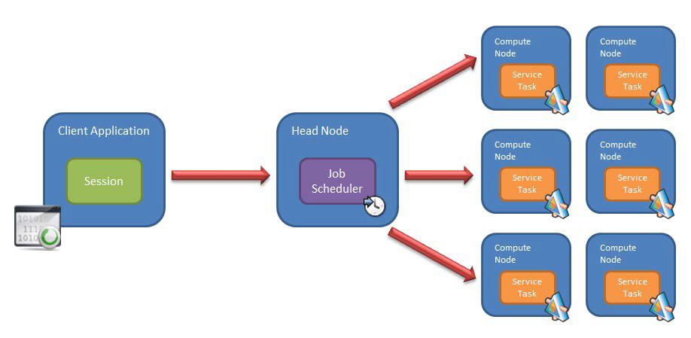
WHY JOB SCHEDULER ?
Load Balance
Fair-Share
Automation
Client in-dependent

Slide 3
PBS JOB SCHEDULER ?
PBS Job Scheduler
A workload management platform for distributed HPC environments
User Functions: Submit, Check, Hold, Release, Terminate batch jobs
Scheduling Functions: Priorities, Dispatch, Monitor and control the execution of jobs and keep the information of the jobs
Workload Manager: Resource allocation and Load balance

Slide 4
WHERE TO DO THE JOB SUBMISSION ?
PBS Job Submission hosts
atlas6-c01
atlas7-c10
atlas8-c01
atlas9-c01
gold-c01

Slide 5
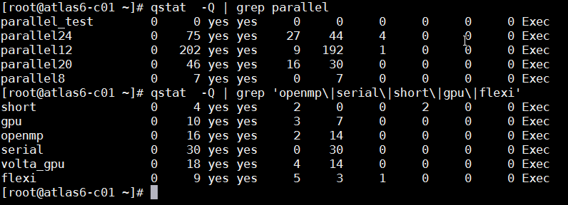
PBS BATCH SUBMISSION QUEUES
List of available batch queues

Slide 6
WHY JOB SCHEDULER ?
Queue Type | Queue Name | Available CPU Cores | Memory Limits (GB)
Parallel | parallel8 | 8,16,24,32 | 45 / node
 | parallel12 | 12,24,36,48 | 45 / node
 | parallel20 | 20,40,60,80 | 160 /node
 | parallel24 | 24,48,72,96 | 160 / node
GPU | gpu | 6,12,18…. And GPUs | 45 / node
 | volta_gpu
Serial | Serial | 1 | 15 / node
Application | Short | 1-12 | 45 / node
 | Openmp | 1-40 (for openmp jobs) | 250 / node

Slide 7
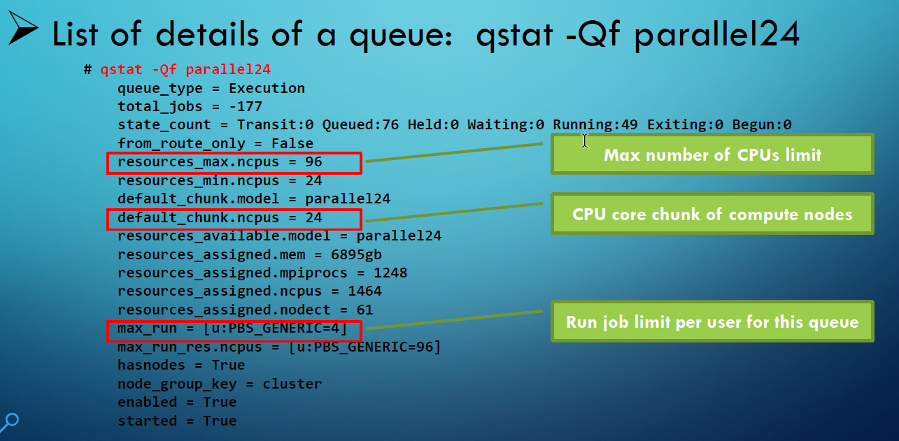
BATCH JOB QUEUES ?

Slide 8
BATCH JOB SUBMISSION ?
PBS Job Submission and Management Summary
Create a job submission script : a text based script file
For Ex: <lammps.pbs.txt>
Submit job via ‘qsub ’ command: qsub <lammps.pbs.txt>
Check the list submitted jobs via ‘qstat’: qstat [-ans] [-aw]
Job mtool: qcat, qtop
Job termination: qdel
Customized PBS Command
hpc pbs summary
hpc pbs help

Slide 9
The module package is available on the Shared Computing Cluster, allowing users to access non-standard tools or alternate versions of standard packages
Module command ?
The module package is available on the Shared HPC NUS Computing Cluster, allowing users to access non-standard tools or alternate versions of standard applications.
Common commands
module list | List currently loaded modules.
module avail | List available packages.
module help [modulefile] | Description of specified module.
module show [modulefile] | Displays information about specified module, including environment changes, dependencies, software version and path.
module load [modulefile] | Loads module or specifies which dependencies have not been loaded.
module unload [modulefile] | Unloads specified module from environment.
module purge | Unloads all loaded modules

Slide 10
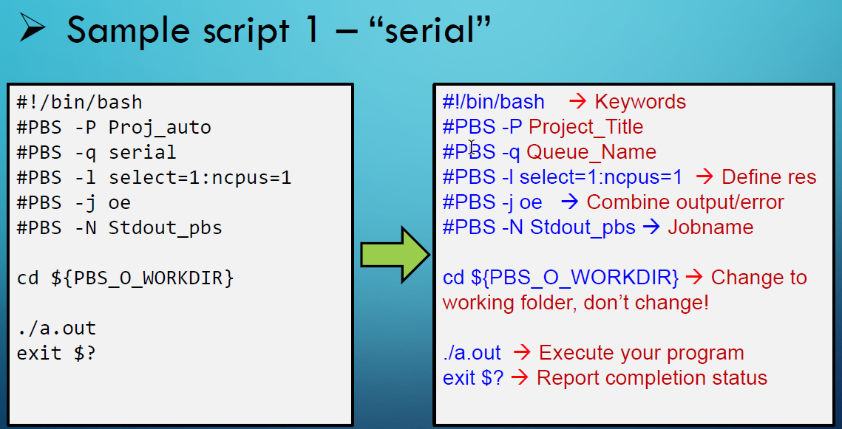
PBS JOB SUBMISSION SCRIPT

Slide 11
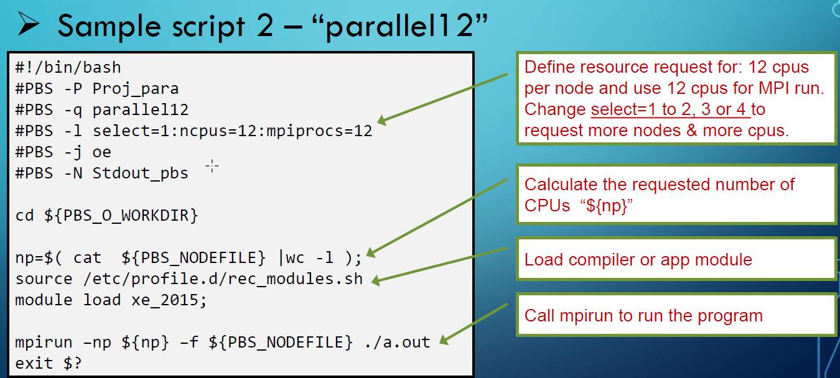

Slide 12
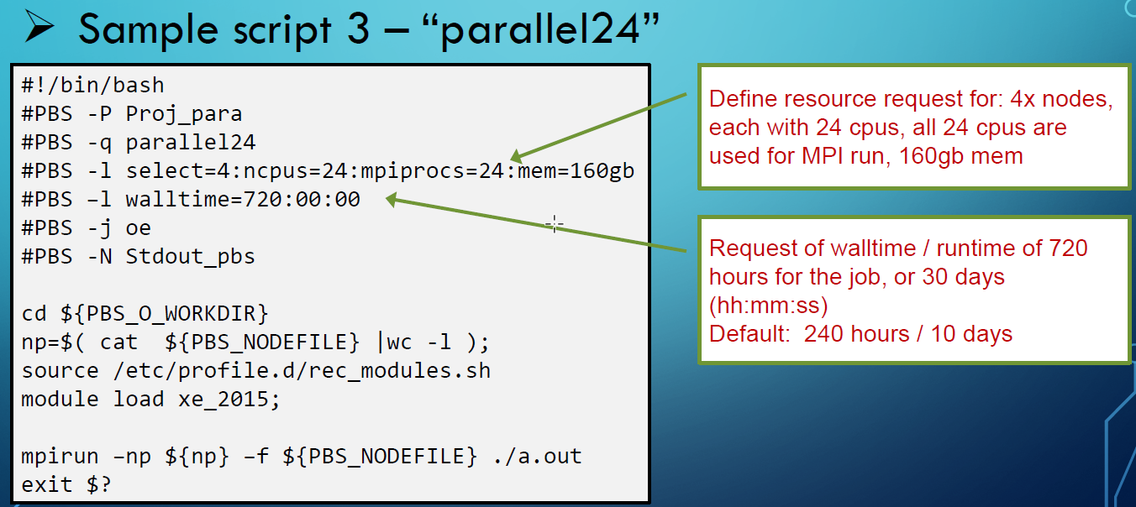

Slide 13
BATCH JOB MONITOR AND MANAGE ?
Command “qstat”
List submitted jobs: qstat
List with running nodes & other info: qstat–ans|-aw|-p
List a job with full info: qstat-f jobid
Command “qcat”: view standard output message
qcat–j jobid–t OUT [ |less ]
Command “qtop”: view processes on compute nodes
qtop jobid

Slide 14
AUTOMATED JOB SUBMISSION (1)
Simple serial jobs using 1 cpu core
Command: qsub-auto –q serial “./a.outinput1.dat”
Job script file will be auto-created as _pbs_***.txt
Matlabjob submission
Standard Matlabjob: matlab-job program1.m
Parallel Matlabjob: matlab-job program1.m -parallel

Slide 15
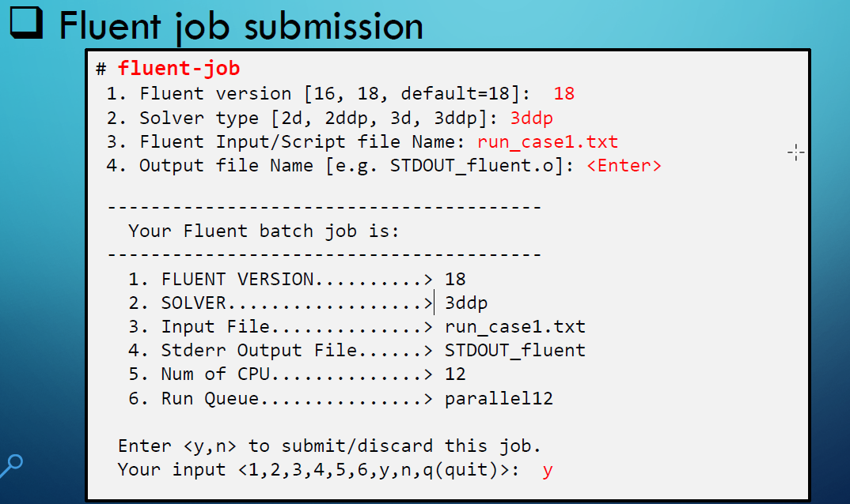
AUTOMATED JOB SUBMISSION (2)

Slide 16
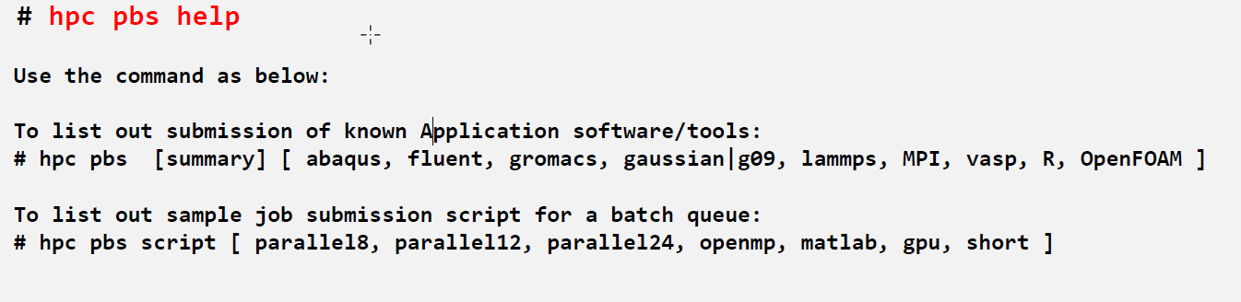
OTHER TOOLS – (1)
Check Load Status of HPC Cluster and Queues
Command: hpc pbs summary | help

Slide 17
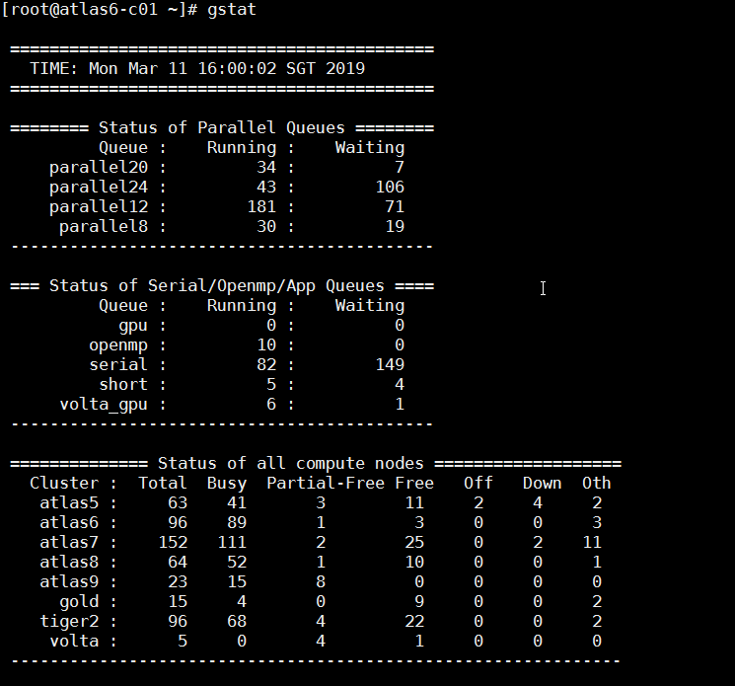
OTHER TOOLS – (2)
Check Load Status of HPC Cluster and Queues
Command: gstat or ( hpc q )

Slide 18
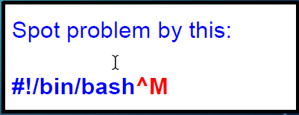
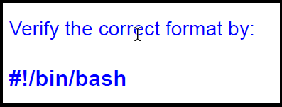
COMMON PROBLEM
Wrong format of text-based script file, introduced by line terminators CLRF when uploaded from Windows
Exists in job script, UDF (C/Fortran program), Matlabm-file, Abaqus/Gaussian *.com file, input *.txt or *.datfiles
Steps to Correct the wrong format or error (e.g. file name as “script.txt”):
Check problem: cat -v script.txt
Correct the wrong format: dos2unix script.txt
Verify the correction: cat -v script.txt

Slide 19
DEBUG AND TROUBLESHOOT
Check batch job’s detailed info: qstat –fx job-id
Check the program output/results files or logs
Check batch job’s standard output file
Command 1 : less Stdout.o***** (**** represents the jobid)
Command 2 : more stdout.o****
Re-submit the job to verify the issue.

Slide 20
Q & A ?
Thank you

